Slide 1




Deep Spectrum Sensing Under Realistic RF Conditions: A Cross-Dataset Study
Atik Mahabub, Mouna Djellouli, and Shervin Vakili
INRS-EMT, Montreal, Canada
{atik.mahabub, mouna.djellouli, shervin.vakili}@inrs.ca
ECCoLe
Edge Computing, Communication and Learning Lab
Presented By: Atik Mahabub
PhD, Student, INRS-EMT, Montreal, Canada
Email: atik.mahabub@inrs.ca
Date: May 19, 2026

Slide 2
1. Research Objectives
Defining the core challenges in spectrum allocation and outlining the path to robust, machine learning-driven solutions.

Slide 3


The Cognitive Radio Imperative
The rapid expansion of 5G and the impending dawn of 6G connectivity have placed unprecedented strain on the limited radio-frequency (RF) spectrum.
5G
Cognitive Radio (CR) addresses this scarcity by enabling secondary users (SUs) to opportunistically utilize idle frequency bands without causing interference to primary users (PUs).
However, successful CR operation hinges on highly reliable spectrum sensing, particularly when signals are buried in severe noise (low SNR) and realistic channel fading.

Slide 4
The Urgency of the RF Scarcity Problem
Exploding Bandwidth Demand
As we transition into 6G networks, standard static frequency allocation is no longer sustainable.
The demand for bandwidth vastly outweighs the available spectrum allocations.
Dynamic, opportunistic access via CR is mandatory, requiring near-instantaneous and flawless detection of "empty" spectrum slots in increasingly noisy environments.
6G
Imminent Deployment

Slide 5








Core Study Objectives
Unified Formulation
Cross-Dataset Eval
Architecture Compare
Reformulate multiple diverse RF datasets into a standardized binary spectrum sensing task for direct comparability.
Test structural generalization by evaluating models across four distinct, heterogeneous datasets simultaneously.
Evaluate the strengths of four distinct DL architectures (CNN, LSTM, GRU, PETCGDNN) against traditional limits.

Slide 6
2. Novelty & Usefulness
Moving beyond synthetic idealized models to ensure structural generalization in harsh, real-world RF environments.

Slide 7


Addressing Existing Limitations
The Generalization Gap
The Trivial Learning Trap
Many existing DL-based sensing models are structurally heavy and optimized exclusively for a single dataset. This prevents accurate assessment of their cross-dataset generalization and severely limits their feasibility for deployment on resource-constrained edge devices.
Conventional evaluations often represent "idle" channels using pure Additive White Gaussian Noise (AWGN). Models exploit this by learning simple signal-energy cues rather than recognizing complex RF modulation signatures, masking true performance drops.

Slide 8
The Complex RF Baseline
To guarantee a rigorous stress test, we synthesized a standardized Complex RF Background Simulator.
Instead of pure AWGN, the idle class (Signal Absent) is flooded with realistic impairments, forcing the deep learning models to extract robust, discriminative modulation features rather than relying on trivial energy variances.
Colored Noise filtering
Random Narrowband Interference (NBI)
High-amplitude Impulsive Spikes

Slide 9
3. Methodology Pipeline
A structured, end-to-end framework from dataset formulation to performance evaluation.

Slide 10
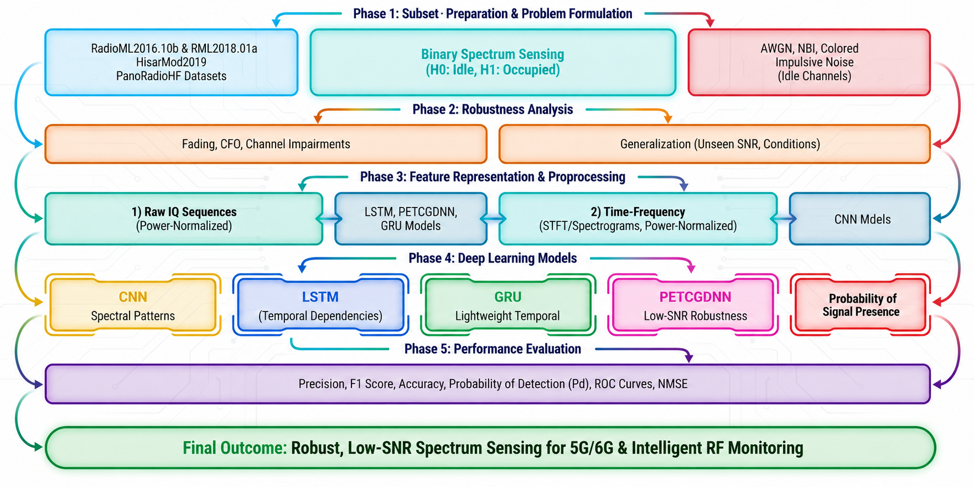
Six-Phase DL-Based Evaluation Architecture

Slide 11
Feature Representations
Raw I/Q Sequences
Time-Frequency 2D
Complex baseband In-Phase and Quadrature (I/Q) samples are fed directly into recurrent and complex-valued models. This preserves vital phase dynamics, temporal dependencies, and subtle waveform geometries critical for surviving low SNR environments.
Short-time windows of I/Q samples are transformed into 2D representations (e.g., spectrograms) for the Convolutional models. This allows CNNs to leverage spatial-spectral filtering to detect localized energy signatures across different sub-carriers.

Slide 12
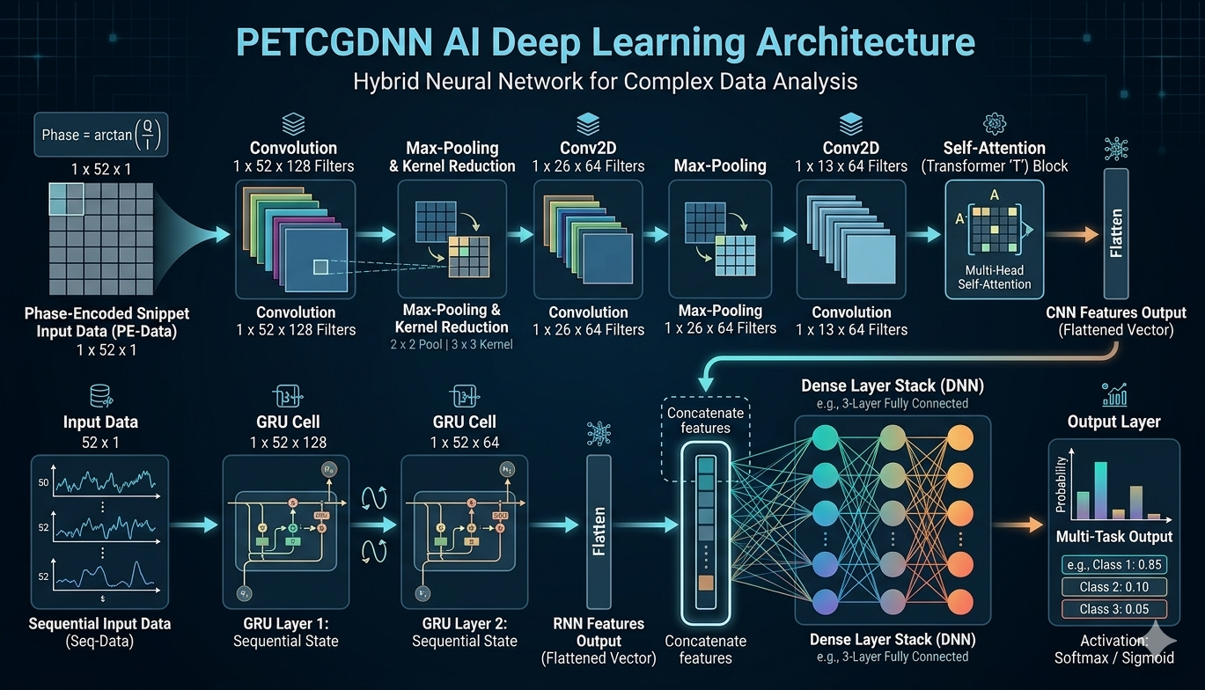
Evaluated DL Architectures
CNN Models
LSTM / GRU
PETCGDNN
Focuses on spatial-spectral filtering and extracting visual-like patterns from frequency distributions
Designed to strictly map temporal dependencies & complex sequence transitions over time
A lightweight, phase-aware network emphasizing extreme low-SNR robustness without memory bloat

Slide 13
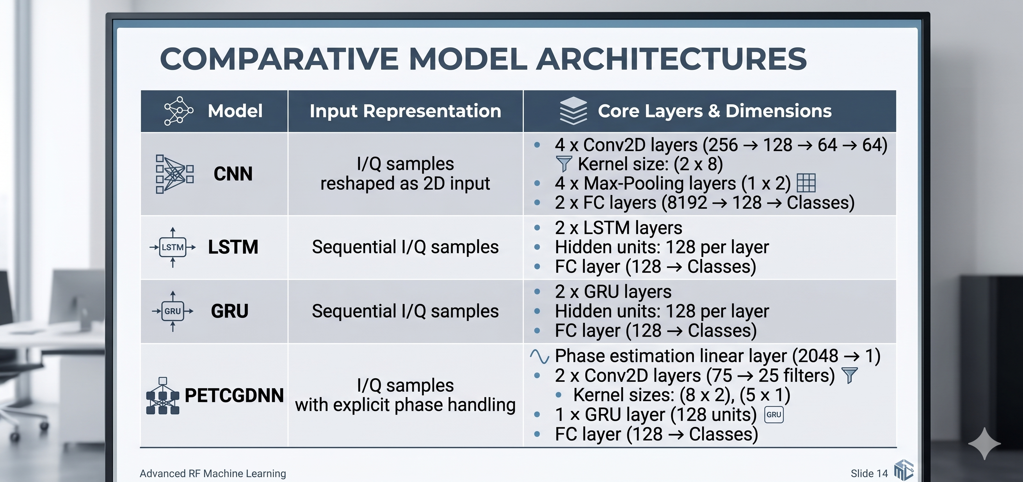
Architecture Deep-Dive

Slide 14
Phase 5: Performance Evaluation
Analyzing model robustness and structural generalization across heterogeneous RF datasets under realistic channel impairments.

Slide 15
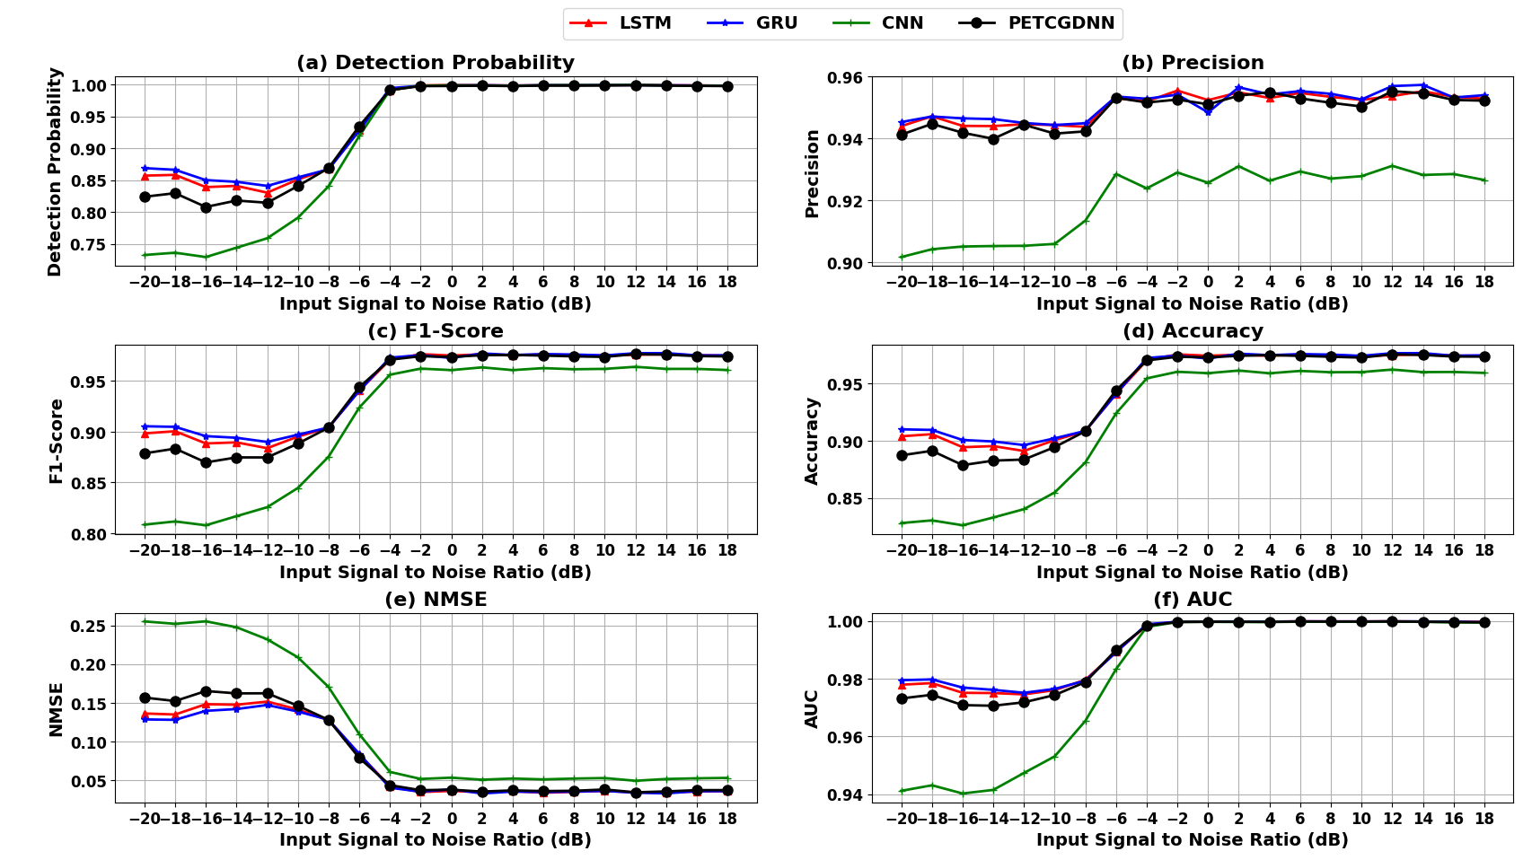
Results: RML2016b Dataset
Baseline Synthetic Immunity
Evaluated on 128×2 I/Q samples with size 1,200,000 over a SNR Range (-20dB to 18dB) against our Complex RF Background Simulator.
Low-SNR Resilience: LSTM achieves ~90% accuracy and >80% Probability of Detection (Pd) below -10dB.
Precision Leaders: PETCGDNN and CNN maintain superior precision across the entire spectrum.
Feature Isolation: Effectively isolates short-burst modulation features from NBI and impulsive spikes.
AUC Stability: Area Under the Curve (AUC) remains exceptionally high (>0.97) even in negative SNR regimes.

Slide 16
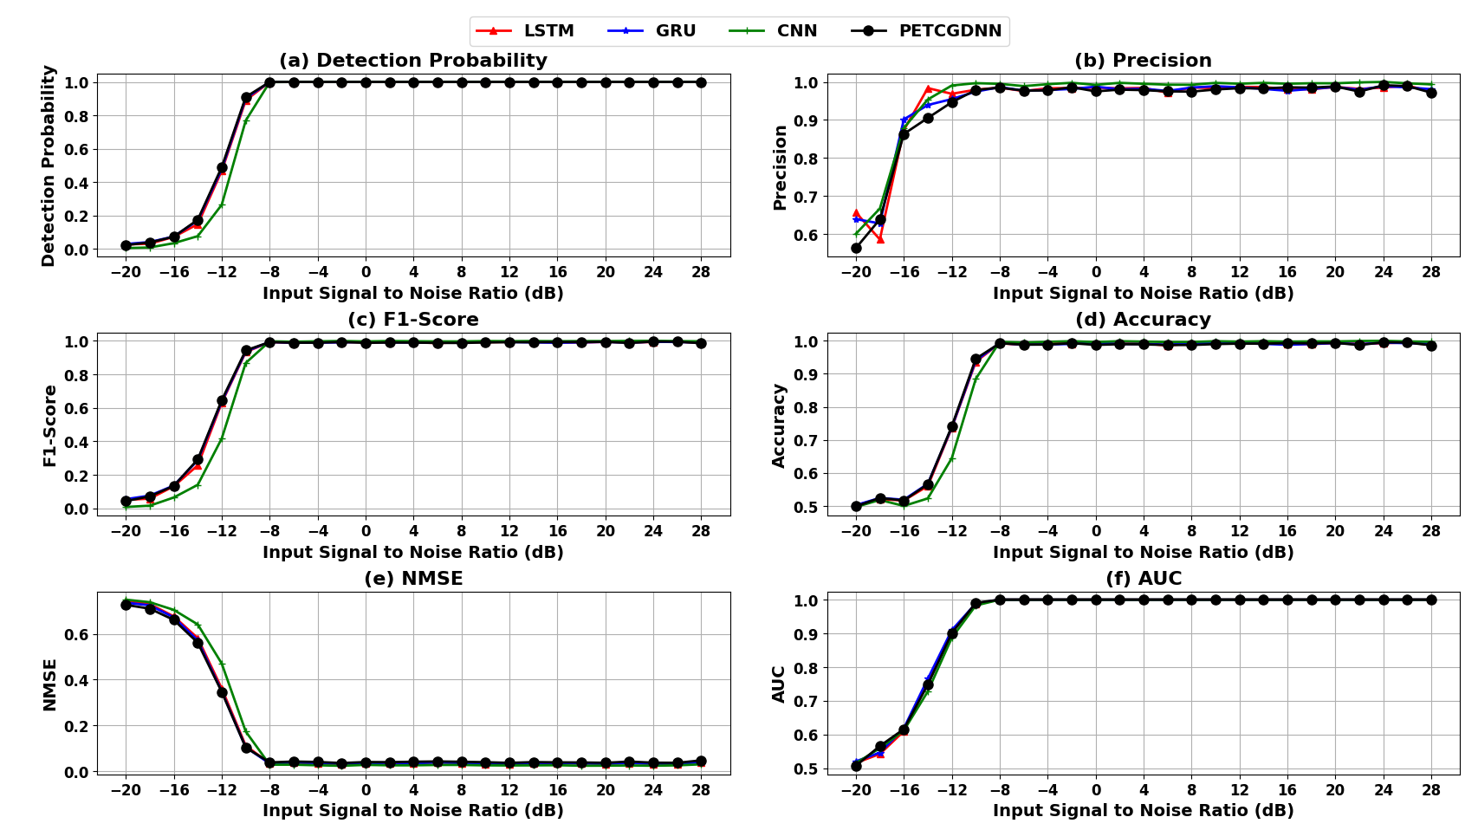
Results: RML2018a Dataset
Impaired Channel Recovery
Testing realistic impairments (multipath fading, CFO, hardware distortions) over longer 1024×2 I/Q samples with size 2,555,904 over a SNR Range (-20dB to 30dB) observation windows.
Standard Model Breakdown: At a severe -20 dB SNR, baseline LSTM exhibits a near 50% accuracy drop with only a 2.5% Probability of Detection (Pd).
PETCGDNN Recovery: Rebounds remarkably against multipath fading, achieving 100% Pd and >98% accuracy as SNR approaches +6dB.
Spatial Feature Extraction: CNN and hybrid layers proved critical here, mapping localized time-frequency distortions much more efficiently than purely sequential networks.

Slide 17
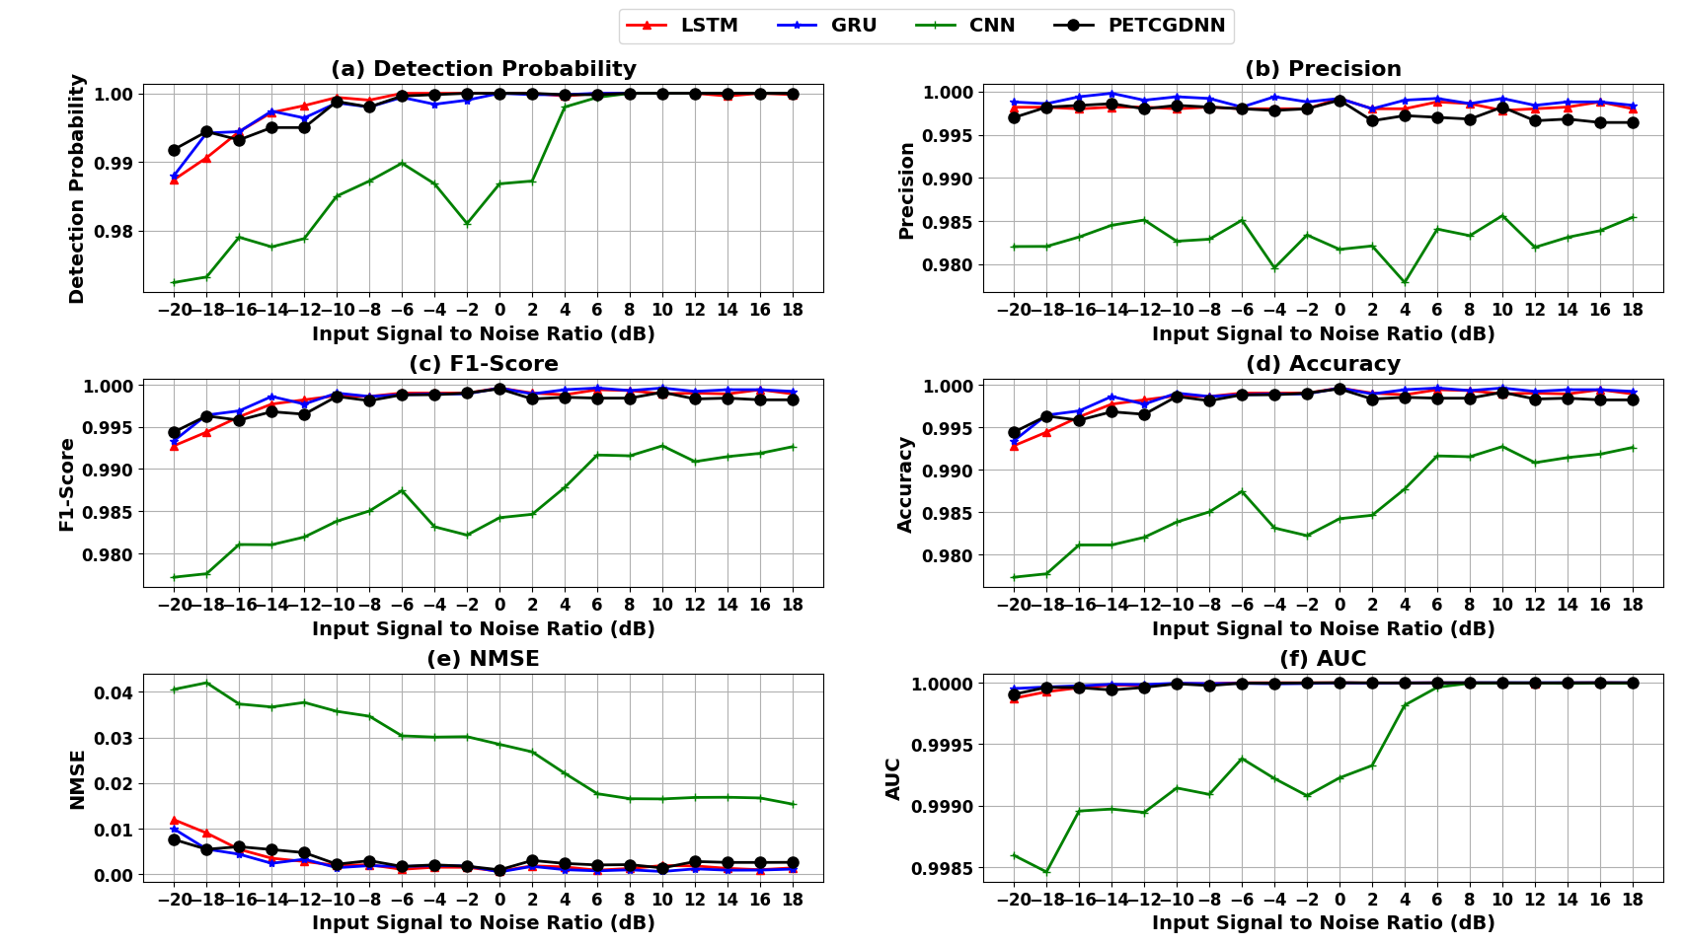
Results: HisarMod2019 Dataset
Dynamic Mobile Environments
Subjected to time-varying channel conditions modeling Doppler effects and extreme multipath propagation.
Dataset: 1024×2 I/Q samples with size 780,000 over a SNR Range (-20dB to 18dB) observation windows.
Overall, Dominance: All evaluated models achieve exceptionally high performance across the entire SNR range.
LSTM Efficiency: Attains 99.3% accuracy and a “Pd” of 98.9% even at severe -20 dB noise floors.
Phase-Aware Precision: PETCGDNN maintains near-perfect F1-scores (>0.998) at all tested levels.
Separability: Distinct pulse shaping and constellations make signals easily separable from colored noise.

Slide 18
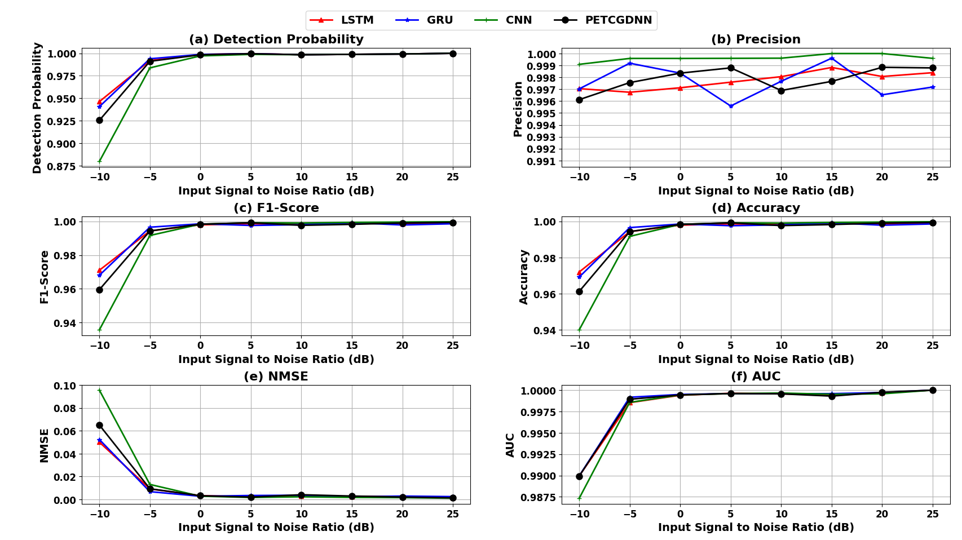
Results: PanoRadioHF Dataset
Real-World Ionospheric Data
The ultimate stress test utilizing real over-the-air High-Frequency (HF) radio signals characterized by non-stationary noise.
Dataset: 2048×2 I/Q samples with size 172,800 over a SNR Range (-10dB to 25dB) observation windows.
Peak Accuracy: All four architectures successfully reach >99% accuracy at 0 dB SNR.
Domain Invariance: Models learned to recognize true domain-invariant phase and frequency transition patterns.
Generalization Check: Successfully classified complex physical HF signals against our purely synthetic interference baselines.

Slide 19
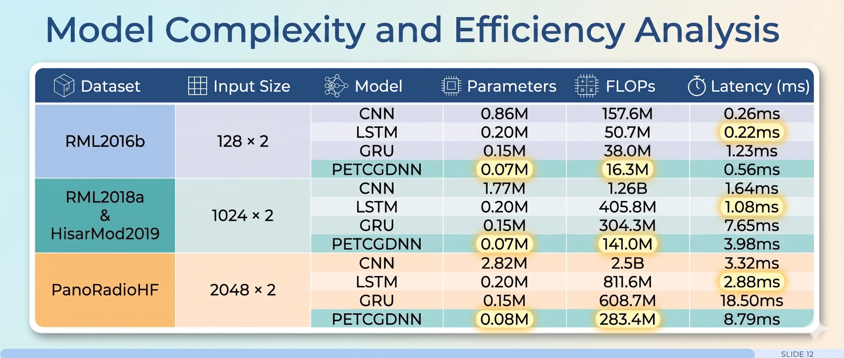
Computational Complexity & Latency
*Table 2: CPU-only inference execution (Intel Core i7-13700, 32 GB DDR5 memory).

Slide 20


Key Research Conclusions
Temporal Dominance
CNN Efficiency
Proven Generalization
Phase-aware and recurrent models explicitly outperform others in deep low-SNR regimes, proving that tracking temporal correlations is critical to surviving multipath fading and CFO.
Convolutional models provide extremely competitive accuracy at moderate-to-high SNRs, boasting parallel inference latency that benefits rapid real-time spectrum scanning operations.
By forcing models against a synthetic complex RF baseline, we prevented trivial energy detection, proving structural generalization across four vastly different data domains.

Slide 21

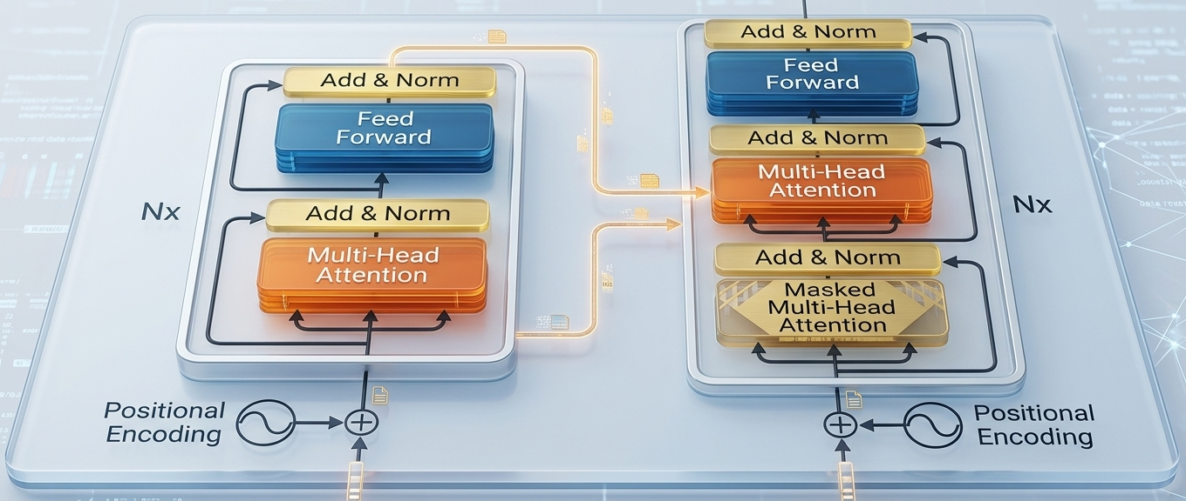
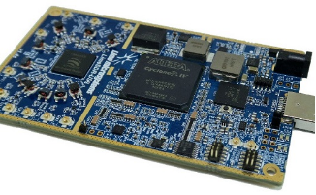


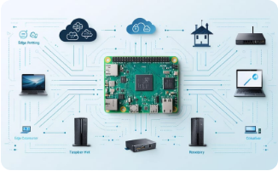
Future Research Outlines
SDR Validation
Transformer Networks
Edge Compression
Transitioning from simulated inference to real-time over-the-air hardware validation using physical Software Defined Radio endpoints.
Exploring self-attention Transformer architectures specifically tuned for ultra-long sequence modeling across wideband spectra.
Aggressive model quantization and compression designed to deploy lightweight cognitive capabilities directly onto IoT devices.

Slide 22
Questions?
Thank you for your attention
Institut national de la recherche scientifique (INRS-ÉMT) | Montreal, Canada

